Slide 1

Industrial Robots

Slide 2
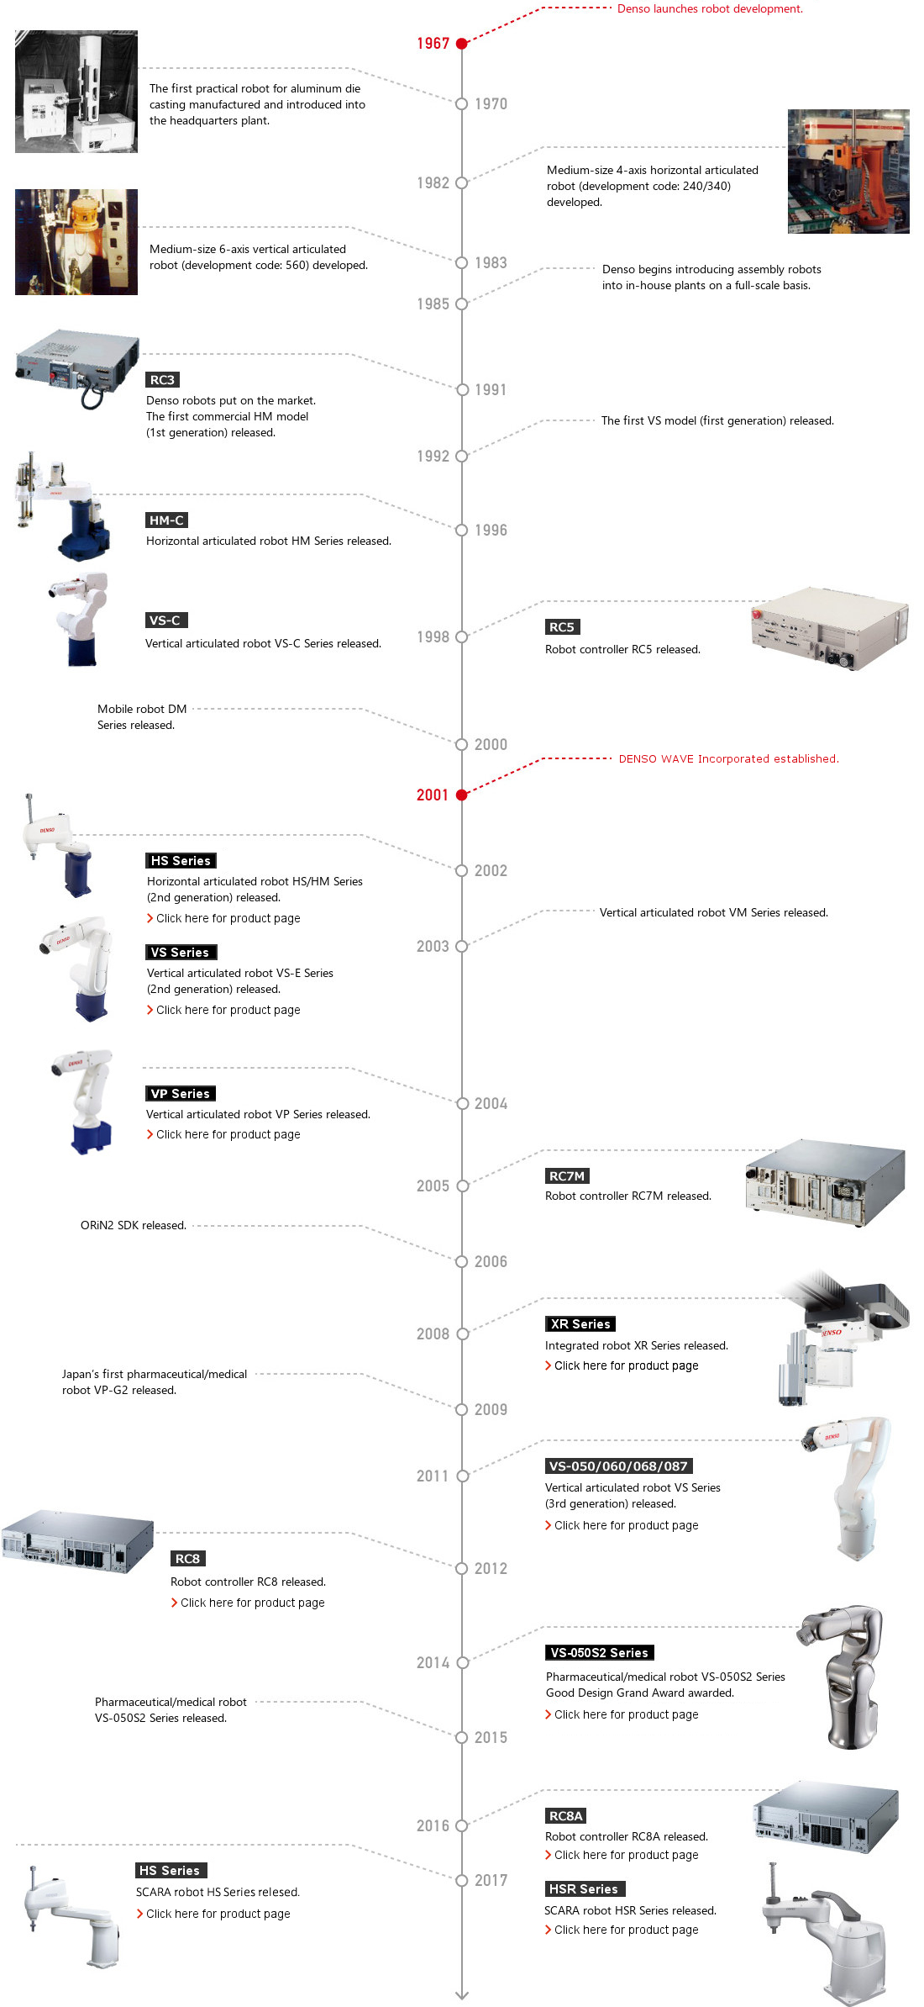
History of Industrial Robots

Slide 3
History of Industrial Robots

Slide 4
Types of Industrial Robots
Articulated robots
Cartesian coordinate robots
Cylindrical coordinate robots
Spherical coordinate robots
SCARA robots
Delta robots

Slide 5
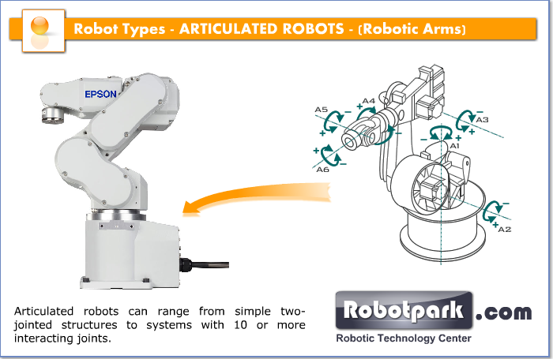
Articulated robots
Articulated robots are the most common industrial robots. They look like a human arm, which is why they are also called robotic arm or manipulator arm. Their articulations with several degrees of freedom allow the articulated arms a wide range of movements.

Slide 6
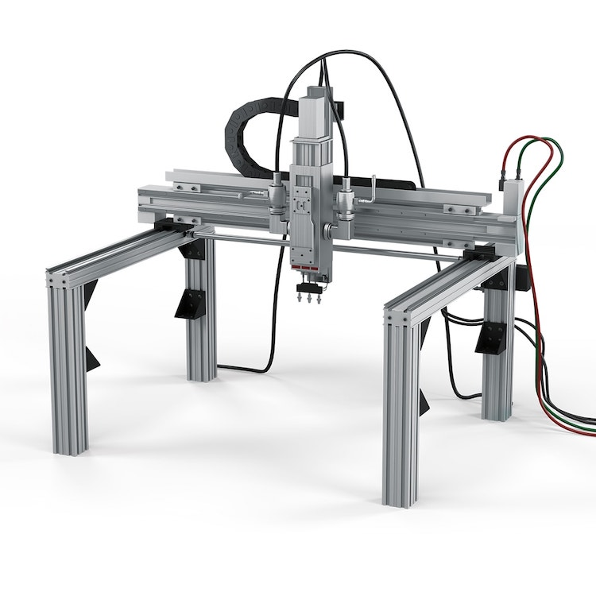
Cartesian coordinate robots
Cartesian robots, also called rectilinear, gantry robots, and x-y-z robots have three prismatic joints for the movement of the tool and three rotary joints for its orientation in space.
To be able to move and orient the effector organ in all directions, such a robot needs 6 axes (or degrees of freedom). In a 2-dimensional environment, three axes are sufficient, two for displacement and one for orientation.

Slide 7
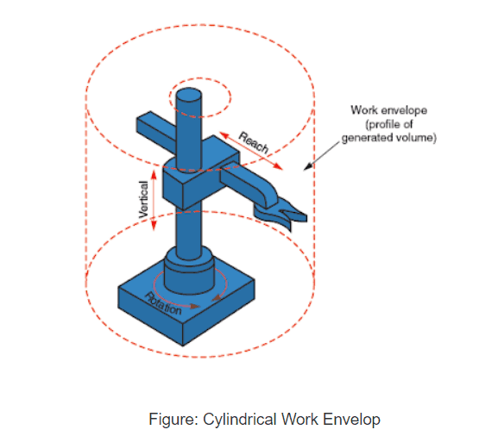
Cylindrical coordinate robots
The cylindrical coordinate robots are characterized by their rotary joint at the base and at least one prismatic joint connecting its links. They can move vertically and horizontally by sliding. The compact effector design allows the robot to reach tight workspaces without any loss of speed.

Slide 8
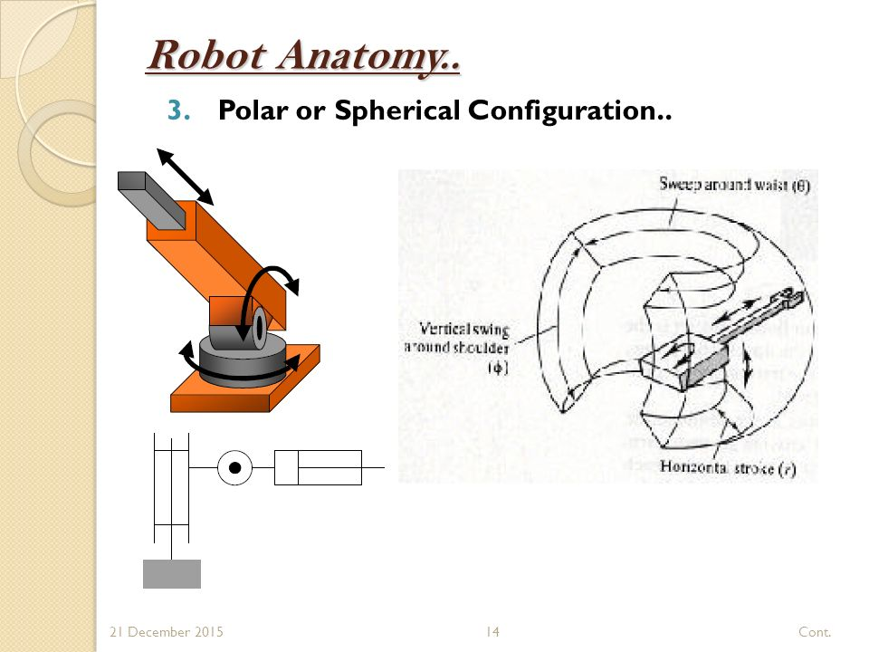
Spherical coordinate robots
Spherical coordinate robots only have rotary joints. They are one of the first robots to have been used in industrial applications. They are commonly used for machine tending in die-casting, plastic injection and extrusion, and for welding.

Slide 9
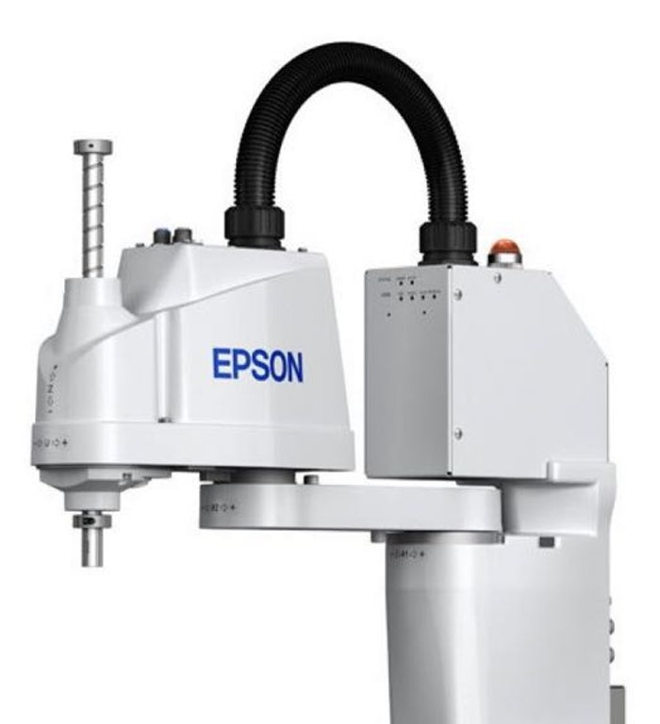
SCARA robots
SCARA is an acronym for Selective Compliance Assembly Robot Arm. SCARA robots are recognized by their two parallel joints which provide movement in the X-Y plane. Rotating shafts are positioned vertically at the effector..
SCARA robots are used for jobs that require precise lateral movements. They are ideal for assembly applications.

Slide 10
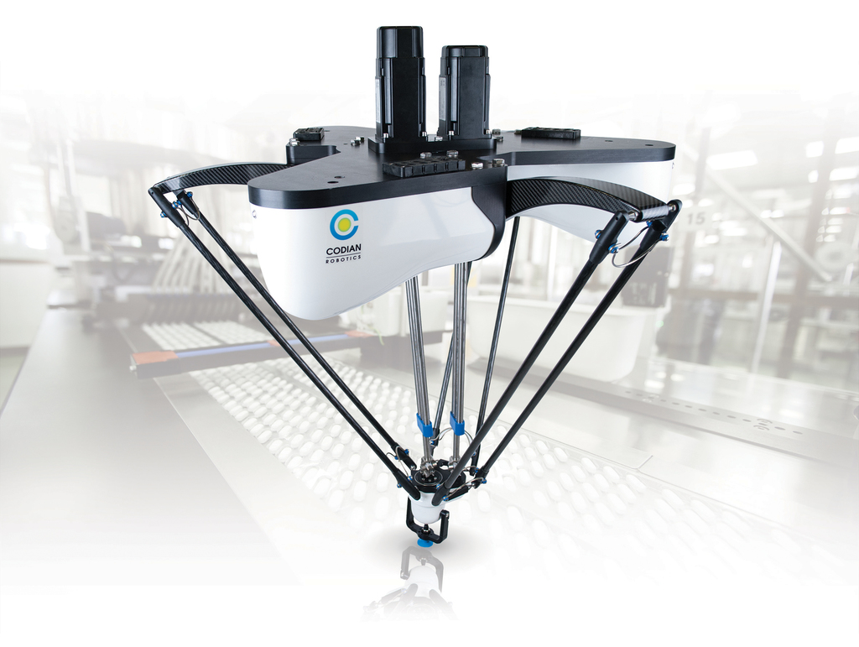
Delta robots
Delta robots are also referred to as parallel link robots. They consist of parallel links connected to a common base. Delta robots are particularly useful for direct control tasks and high maneuvering operations (such as quick pick-and-place tasks). Delta robots take advantage of four bar or parallelogram linkage systems.
Furthermore, industrial robots can have a serial or parallel architecture.

Slide 11

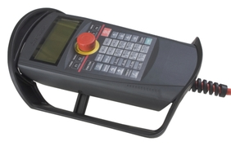
Controllers
R32TB Pendant

Slide 12
Data Transmission

Slide 13
Data Transmission

Slide 14
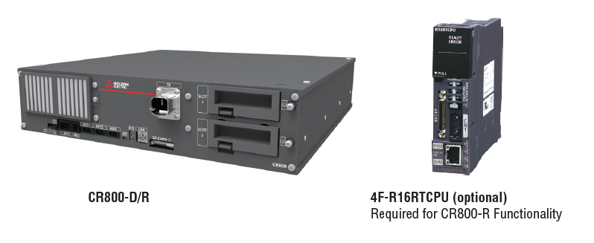
Power System Management

